Slide 1
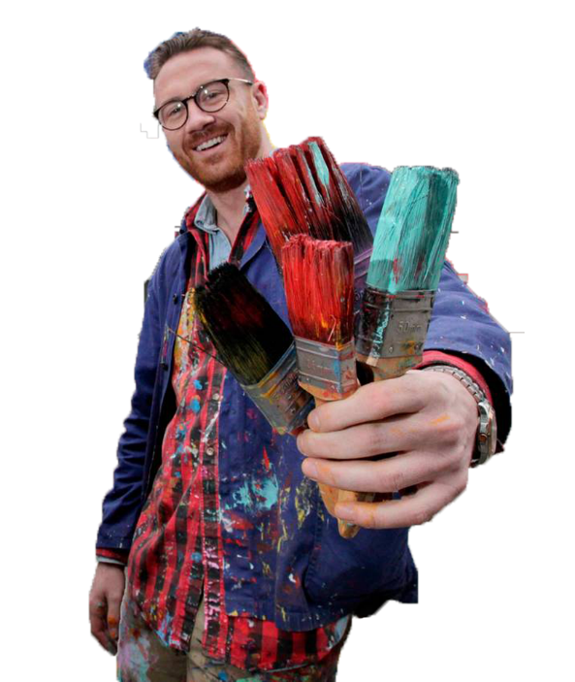
Maser
Students: Emmanuel Ogbonna (13368781) & Mark Carley (20071864)
Class Presentation: Assignment 1

Slide 2
Artist Background

Slide 3
Background to Artist himself
Originally from Dublin Ireland, real name being Al Hester before moniker ‘Maser’.
Is an Irish contemporary artist. Started as a graffiti artist in Dublin at the age of 14.
Studied Visual Communication at Art School in Dublin. Went on to establish himself as one of Ireland’s leading visual artist working in urban environments.
Has opened his own gallery space to the public on Charlemont Street on the 7th December 2018.

Slide 4
Influences to Artist

Slide 5
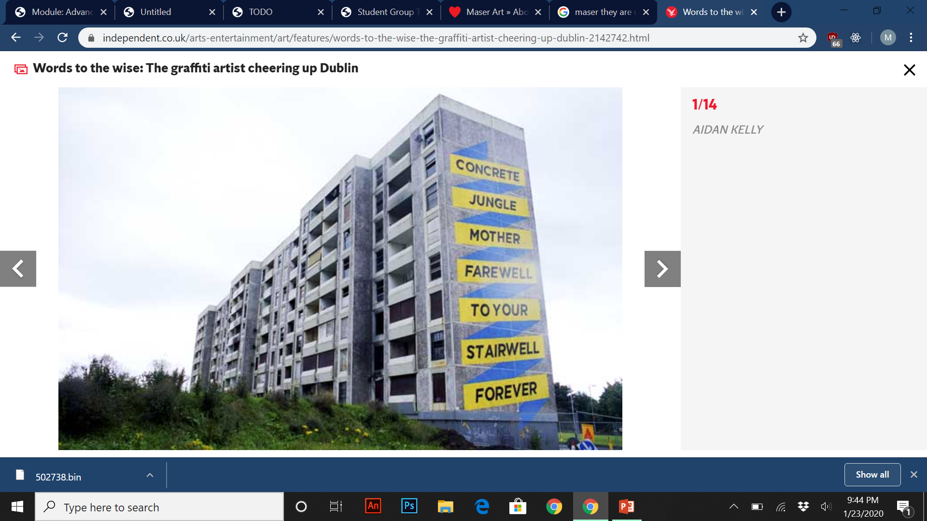
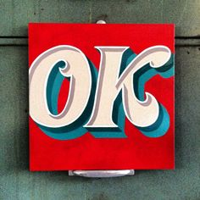
Artist Influences
Some of his earlier work “They Are Us” Project in 2010 was strongly influenced by typography, letterforms and sign painting.
Basic example of sign painting.
“They Are Us” by Maser.

Slide 6
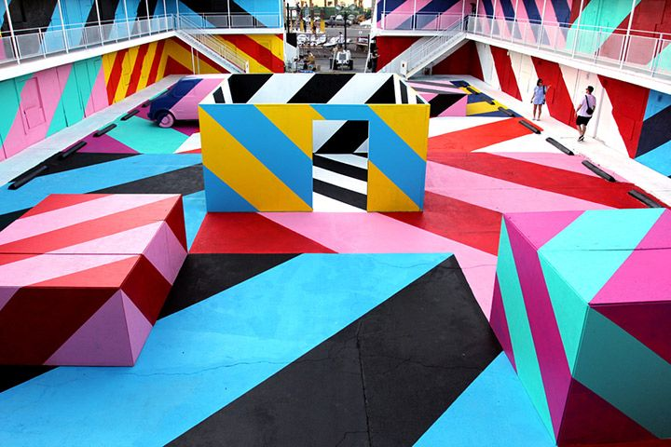
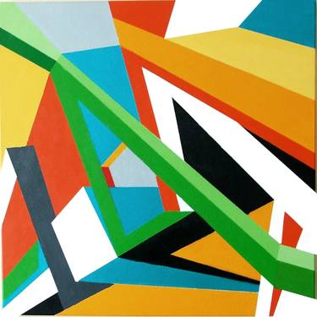
Artist Influences
Soon after 2010, Maser’s style gradually began to transition towards a graphic representation and geometric abstraction.
3D geometric abstraction painting by Marek Uhlir.
Geometric 3D street statement called “OFFSET” by Maser.

Slide 7
Artist Projects and Designs

Slide 8
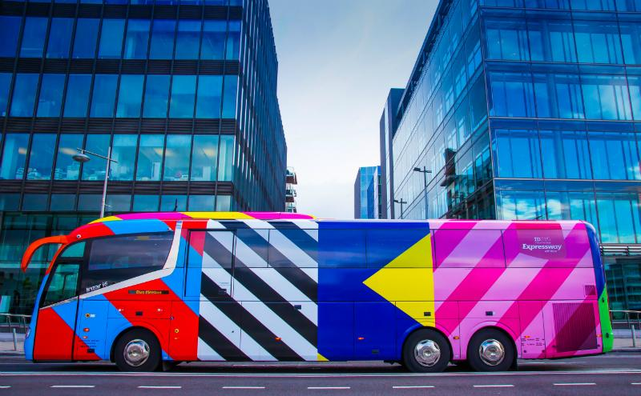
Maser Designs (ID 2015)
Expressway and Irish Design 2015 collaborated with Irish artists to create unique bus wraps. The designs were by Maser, Kevin Thornton and Orla Kiely.
Aim of the project was to demonstrate the breadth of internationally acclaimed Irish designers.
ID 2015 wrap print designs

Slide 9
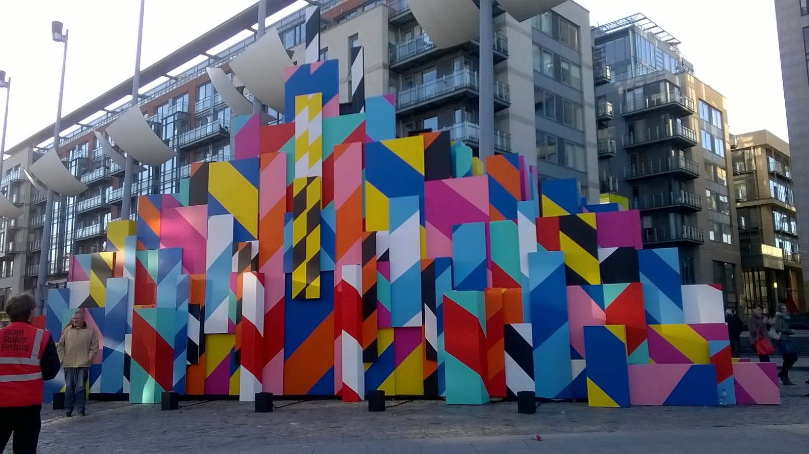
Maser Designs (Bram Stoker festival 2015)
This piece was done by Maser for the Bram Stoker festival 2015 for one weekend in October. It was setup using planks of dark wood with strobe lights with night-clubby beats.
The art piece tries to imitate patterns in cities such as roadworks, warning signs and blocks of colour against blocks of apartments.

Slide 10
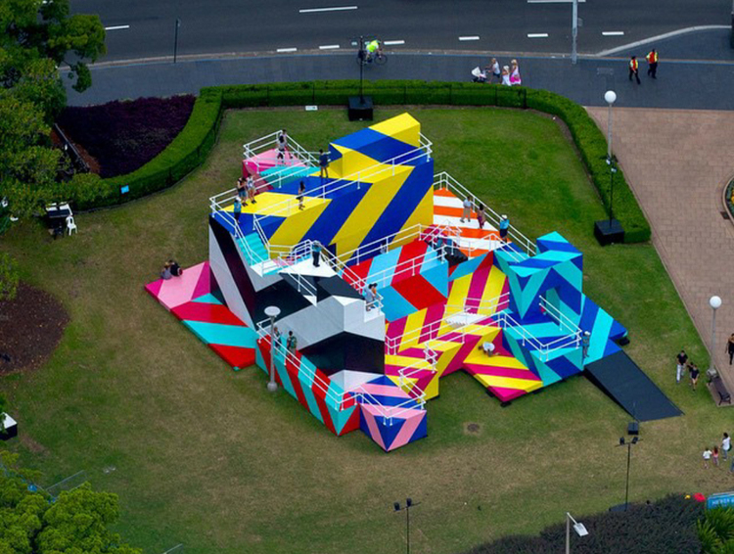
Maser Designs (OFFSET - Hyper Reality)
This piece was created at Australia’s Sydney Festival located in Hyde Park. Composed of a two-story interactive art installation titled “Higher Ground”.
Was open to the public to explore and known for a more unique, abstract style. Was inspired by the work of Dutch artist M.C. Escher.
The art piece seeks to examine the theme of impossibility and infinity.

Slide 11
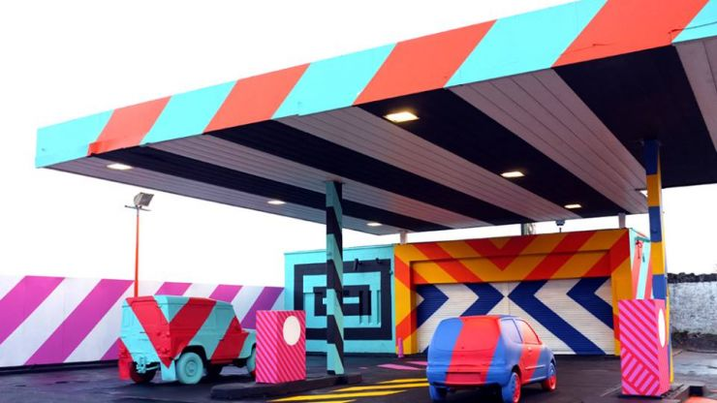
Maser Designs (No.27 – 2014)
A derelict petrol station transformed into a urban art project that’s located in Parnell Street, Limerick.
An interactive installation as part of a transformative urban art project and as a nod to “Ed Ruscha” (American artist associated with pop art movement).
Maser created the work to “surprise people and question their relationship with the familiar and the norm and also how dissociated we are from the space around us.”

Slide 12

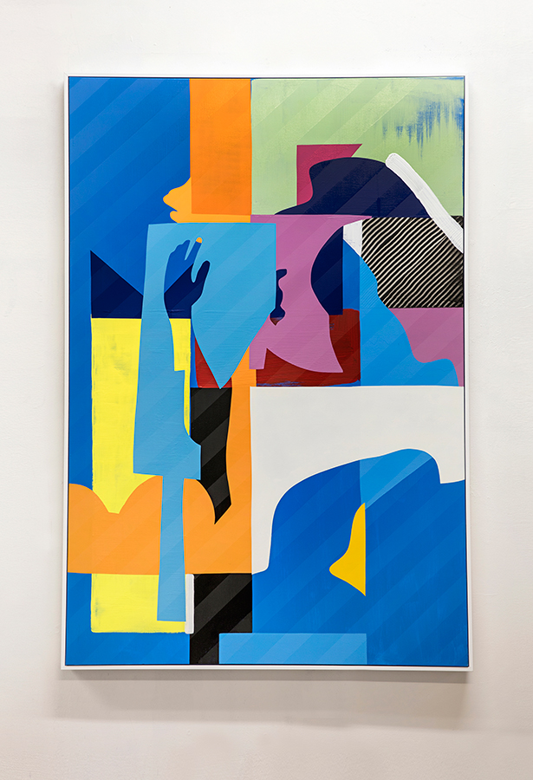
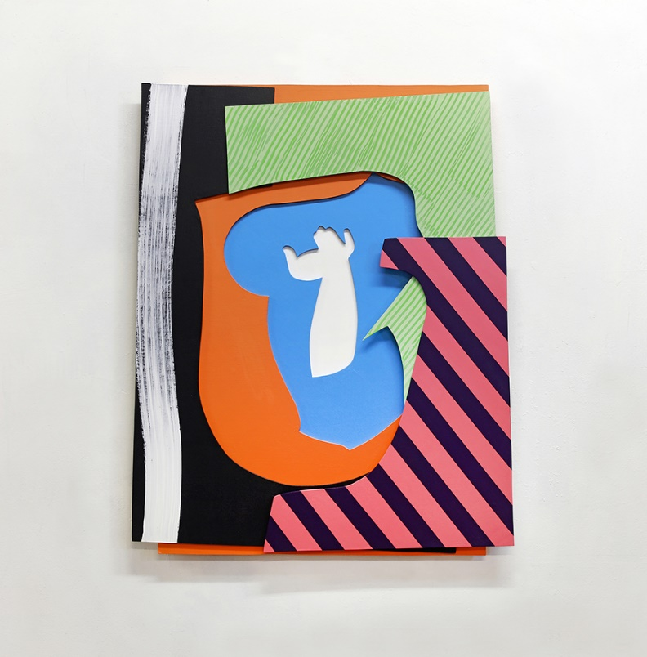
Maser Designs (Canvas pieces)
More pieces found at http://maserart.com/projects/canvas/

Slide 13
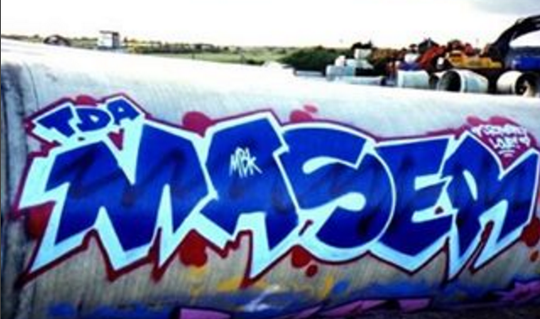
Maser Style
Masers styles he uses are Graffiti, Stripes, Bold deconstructed shapes large on canvases in his Dublin base. He got his style as a 15-year-old spray painting Dublin walls with stencils, something he did fanatically in the mid 1990s.
He got his style from skewing letter forms that’s where he also developed the maser tag that became his artist name.

Slide 14
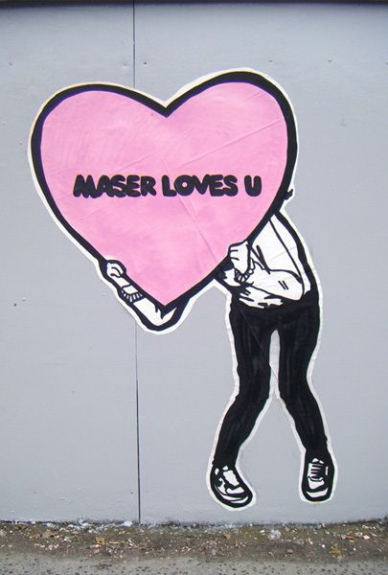
Maser Styles (Maser Loves U)
Common features styles in many of maser works include stripes, love hearts. In his creative work Maser is known for giving a positive message and simple style shown in his work such as “Maser loves U” which has become somewhat iconic and instantly recognisable around Dublin to the love “Love yourself today”, “Don’t be afraid” inspired by Seamus Heaney Irish Noble prize winner.

Slide 15
Maser Styles (Love Yourself Today)
His positive artwork “love yourself today” which is a collaboration print with Irish musician Damien Dempsey. Maser and Dempsey have worked on many projects together over the years. They are old friends with similar belief systems this work was created and design to promote self value and worth.

Slide 16
Maser Designs
Maser made his name from covering walls with illicit artwork. His designs give good vibes shown in his common use of Love Heart symbol in his works.
Maser’s has abstract designs generally are intended to engage and provoke thought, often having a strong message. This design is shown in his work in the repeal the 8th mural in support of the Irish constitution which went on to become the official emblem of the country’s campaign for increased abortion rights.

Slide 17
Maser Designs
Masers Design have spread across murals, posters, building and onto graphic yoga mats. He launch a limited-edition yoga mat in collaboration with Flowstate a new fitness and lifestyle Irish business in April 2019.

Slide 18
Maser Yoga Mats
Maser collaborated with fitness coach Adrienne Murphy to combine Art movement which helps with exercise and meditation becoming more of a lifestyle. “There is very little joy to be got from a downward dog on a discoloured, worn, sad-looking yoga mat.” Masers art yoga mats give bursting with vivid colours and overlaid monochrome chevrons.

Slide 19
Questions

